Slide 1
Psychology 202b Advanced Psychological Statistics, II
April 28, 2011

Slide 2
The Plan for Today
Review of regression assumptions.
Introduce hierarchical linear models.
Random effects.
Acquiring software.
Working with HLM.
An example using High School and Beyond data.

Slide 3
Regression assumptions
Linear relationships.
Independent errors.
Homoscedastic errors.
Normally distributed errors.

Slide 4
Nested Data and Independence
Example: Students are nested in classrooms; classrooms are nested in schools; schools are nested in districts; districts are nested in counties…
Result: massive problems with assumption of independent errors.

Slide 5
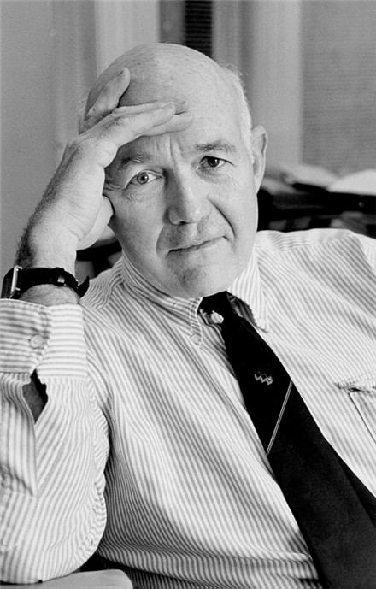
The Coleman Report
Large, federally funded study of Equality of Educational Opportunity.
Concluded that school variables (most notably, funding) did not affect student achievement.
Represented school-level variables as repeated identical scores at the student level.

Slide 6
High School and Beyond
Later, Coleman was a PI on a large, longitudinal study called High school and Beyond.
We’ll use a simple subset of that data set as an example.

Slide 7
HSB Math Achievement
We will focus on HSB’s math achievement outcome.
Primary interest: does student SES affect math achievment?
Secondary interests:
Are public and catholic schools similar in this relationship?
Does school level SES matter?

Slide 8
The levels
Level One: regression of Math on SES.
Level Two: regression of slope and intercept from level one on school characteristics.
We will treat slope and intercept as random effects.

Slide 9
Random effects
Treating the slope and intercept as random effects acknowledges that there is unique variation between schools that is not captured by the model.
We will estimate a variance component for each regression parameter to represent that unique variation.

Slide 10
Acquiring HLM (student version)
You can download a free, restricted version of HLM software here.
Limits:
No more than 5 effects at any level.
3-level models: 8000 level-one units, 1700 level-two units, 60 level-three units.
2-level models: 8000 level-one units, 350 level-two units.

Slide 11
Next time
Using HLM for longitudinal analysis.

