Slide 1
Psychology 202a
Advanced Psychological Statistics
November 3, 2020

Slide 2
The plan for today
The t test as regression (continued)
Introducing multiple regression
Added variable plots

Slide 3
Coding Systems
Digression in R.
Dummy coding
Effects coding
Nonsense coding

Slide 4
The unity of assumptions
Initially, the assumptions underlying regression and the t test appear different.
However, when they are all satisfied, they become the same.

Slide 5
Introducing multiple linear regression
Multiple regression has more than one predictor on the right hand side of the equation.
Example:

Slide 6
When is multiple regression like simple regression?
Illustration with artificial data
The simple regression slope is identical to the multiple regression slope only when the predictors are perfectly uncorrelated.
That won’t happen except by design.
Here’s why:

Slide 7
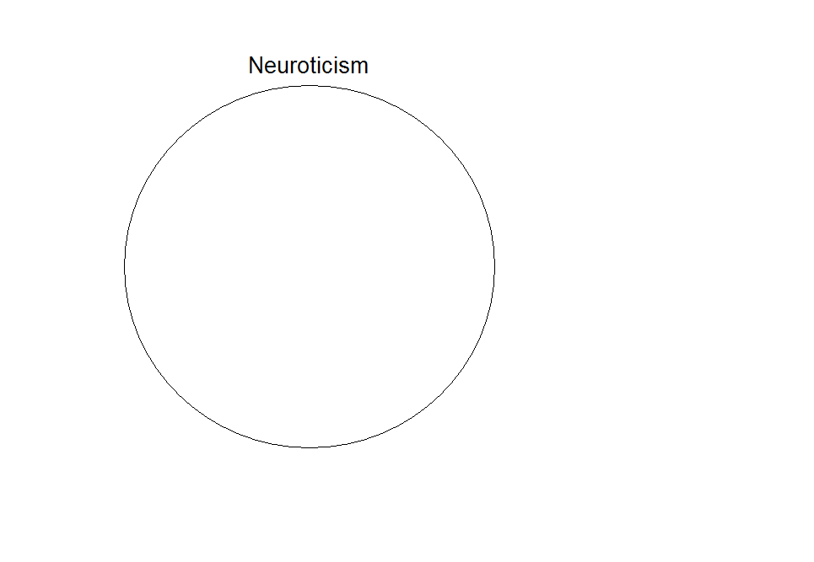

Slide 8
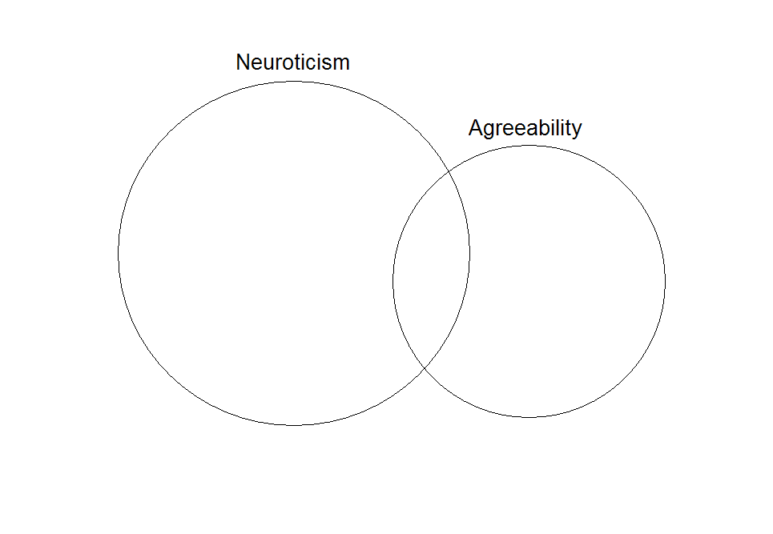
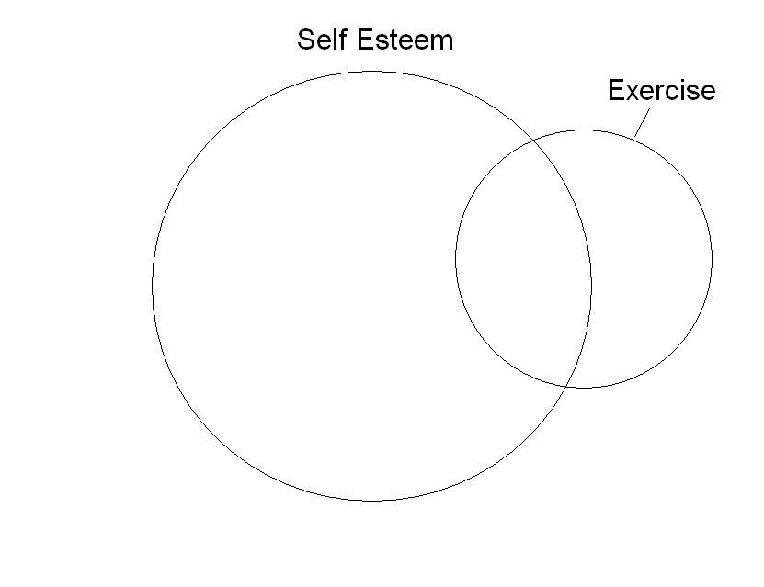
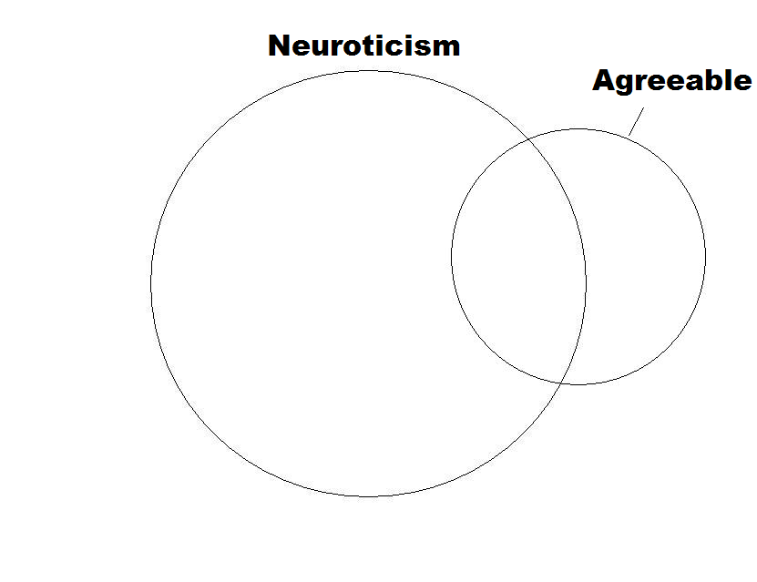

Slide 9
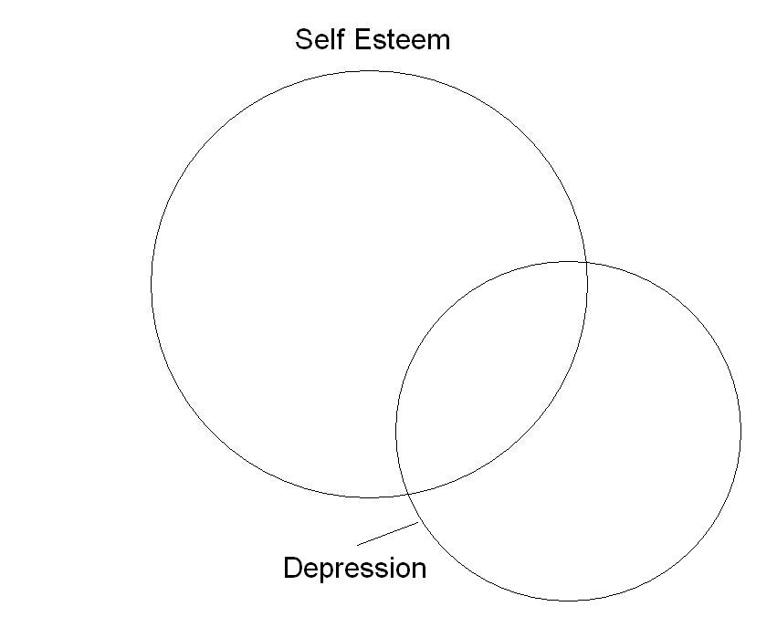
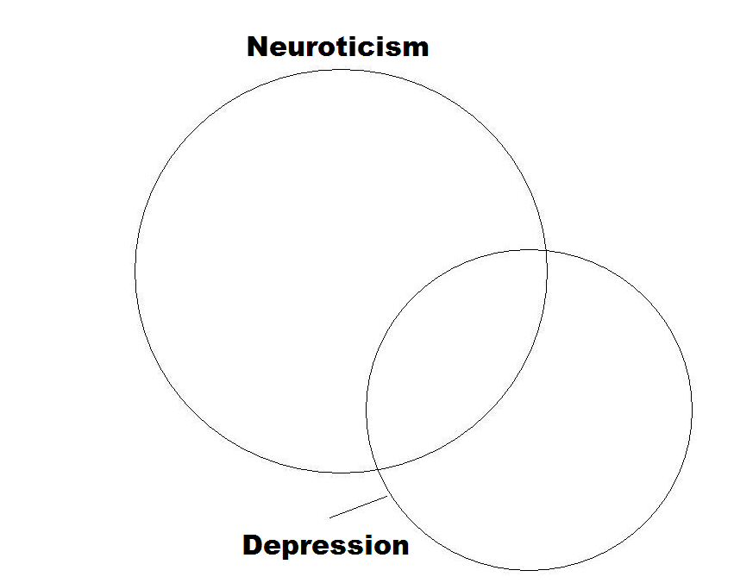
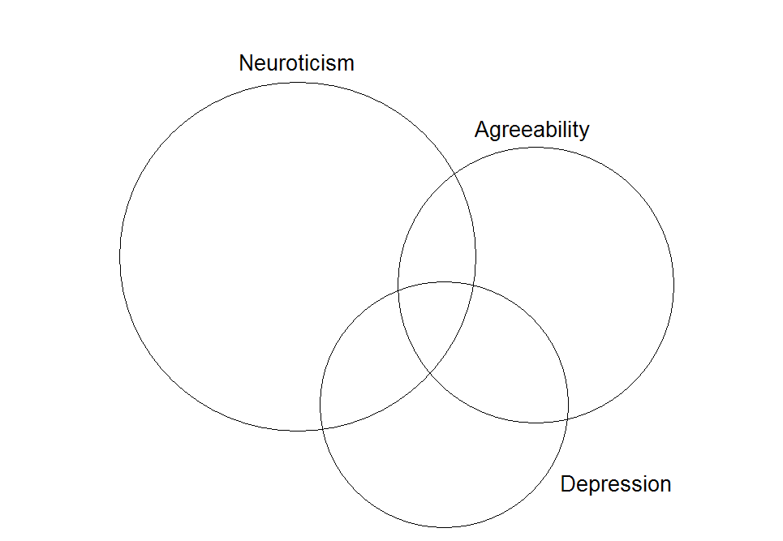

Slide 10
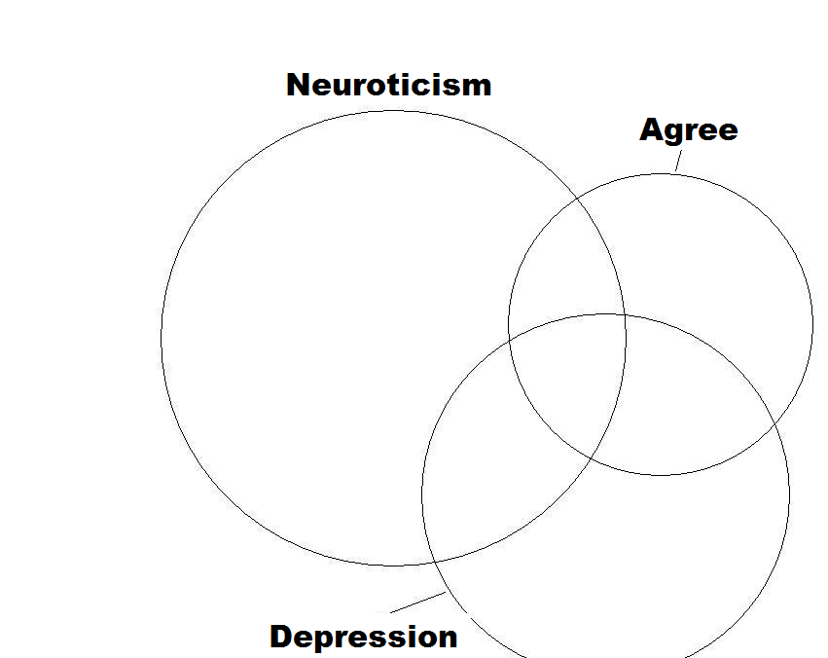
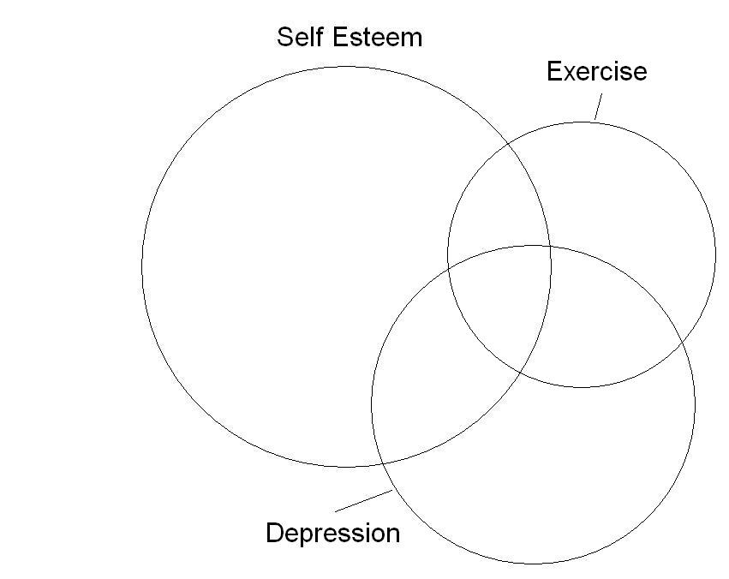
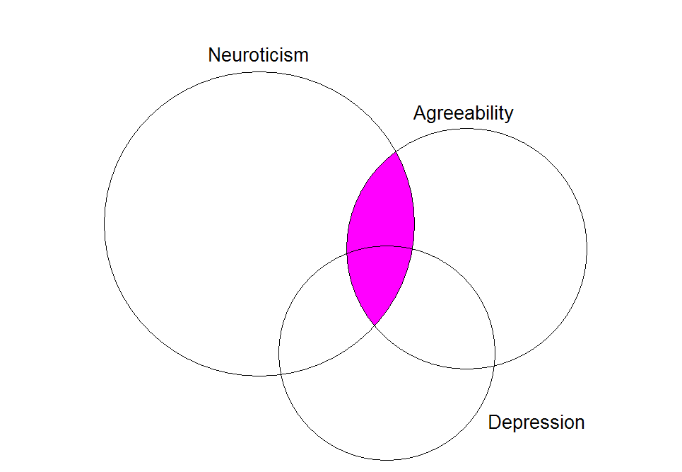

Slide 11
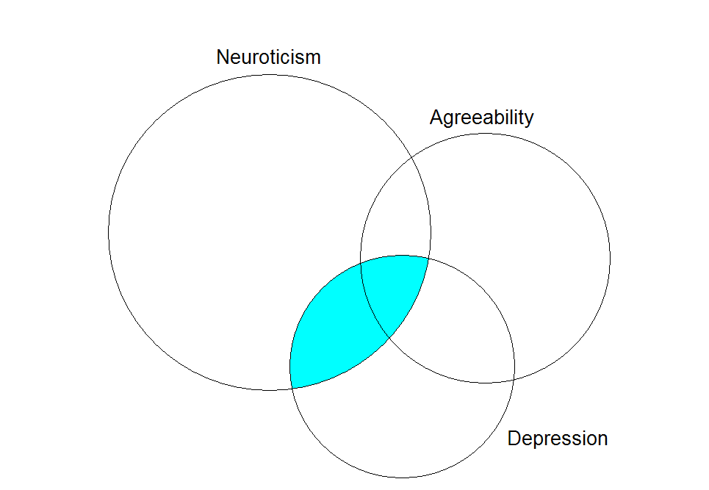

Slide 12
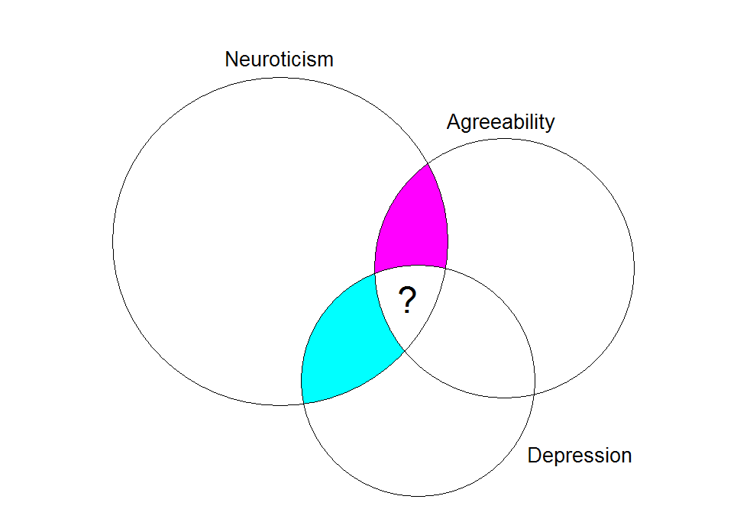

Slide 13
Added variable plots
In order to find what is unique about the relationship between a particular predictor (X₁) and Y
  Isolate the part of Y that cannot be described by other predictors
  Isolate the part of X₁ that cannot be described by other predictors
  Examine the relationship

Slide 14
Added variable plots (cont.)
What part of Neuroticism cannot be predicted by Depression?
The residuals from the regression of Neuroticism on Depression.
What part of Agreeability cannot be predicted by Depression?
The residuals from the regression of Agreeability on Depression.

