Slide 1
Psychology 105
Advanced Research Methods
April 6, 2021

Slide 2
The plan for today
Introducing multiple regression
Sample data set:
  Outcome = “big five” neuroticism score
  Predictors: depression score, “big five” agreeableness score
Can we understand the conditional mean of neuroticism as a function of depression and agreeableness?

Slide 3
Introducing multiple linear regression
Multiple regression has more than one predictor on the right hand side of the equation.
Example:

Slide 4
What does it mean?
Simple regression posits that the conditional mean is a linear function of the predictor.
Regression with two predictors posits that the conditional mean is a plane function of the predictors.
Three predictors? A plane that changes over time.
More? p-dimensional hyperplane.

Slide 5
When is multiple regression like simple regression?
Illustration with artificial data
The simple regression slope is identical to the multiple regression slope only when the predictors are perfectly uncorrelated.
That won’t happen except by design.
Here’s why:

Slide 6
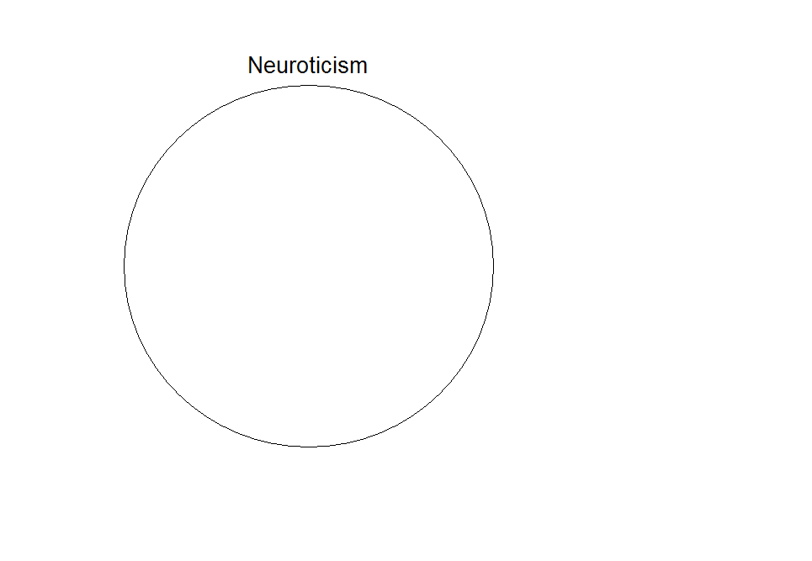

Slide 7
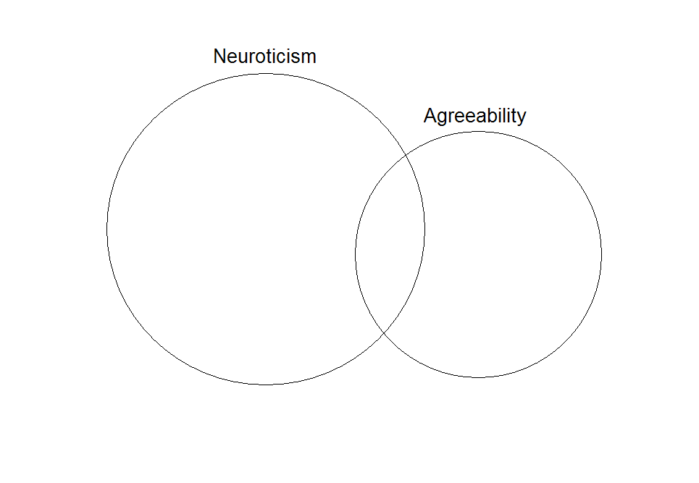
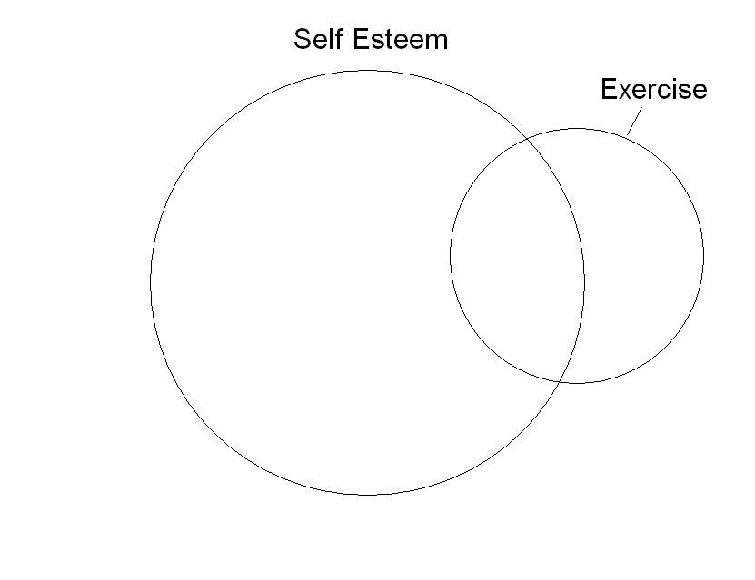
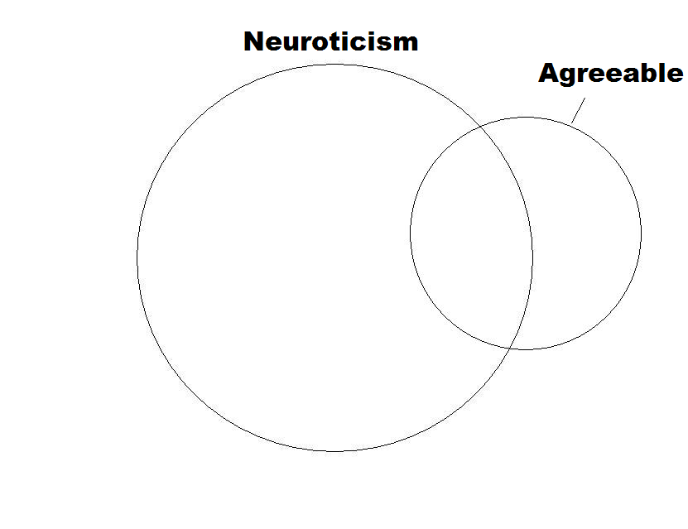

Slide 8
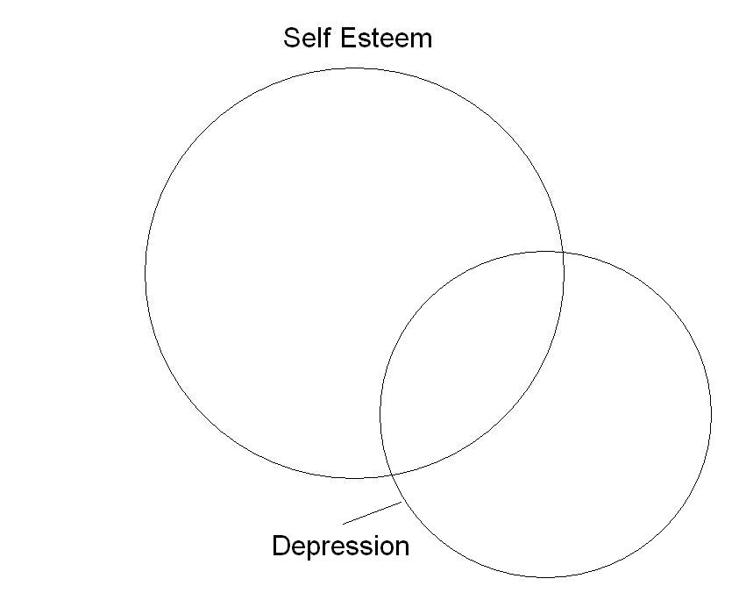
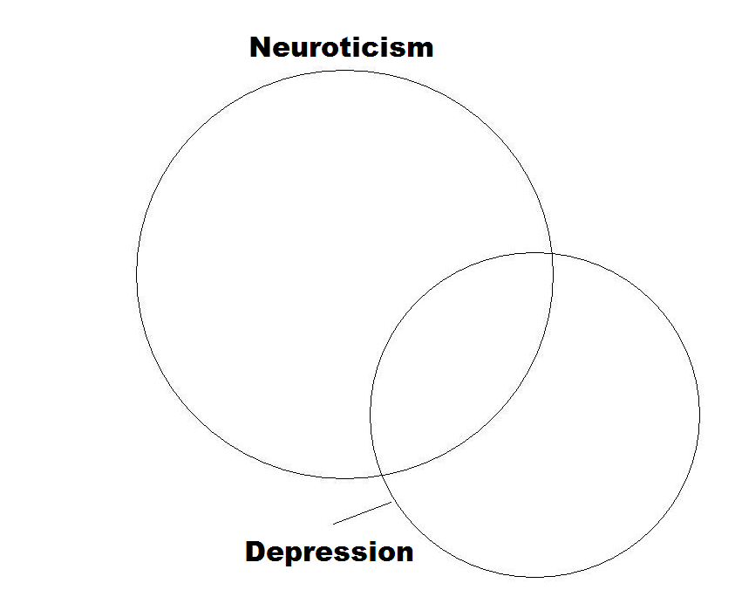
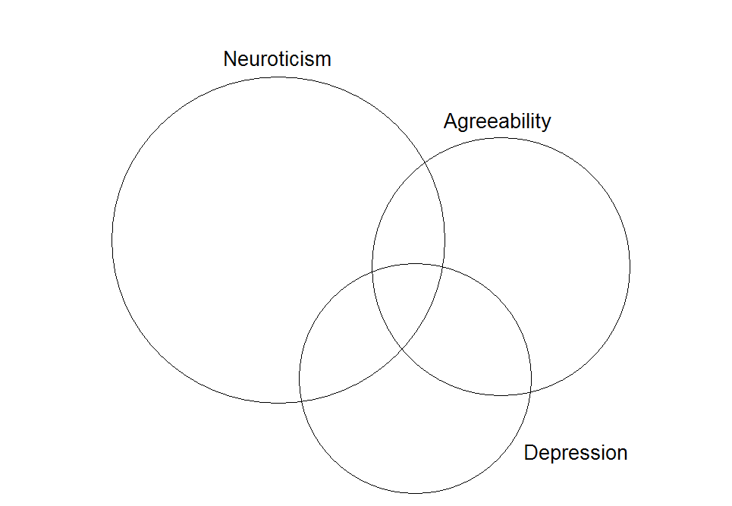

Slide 9
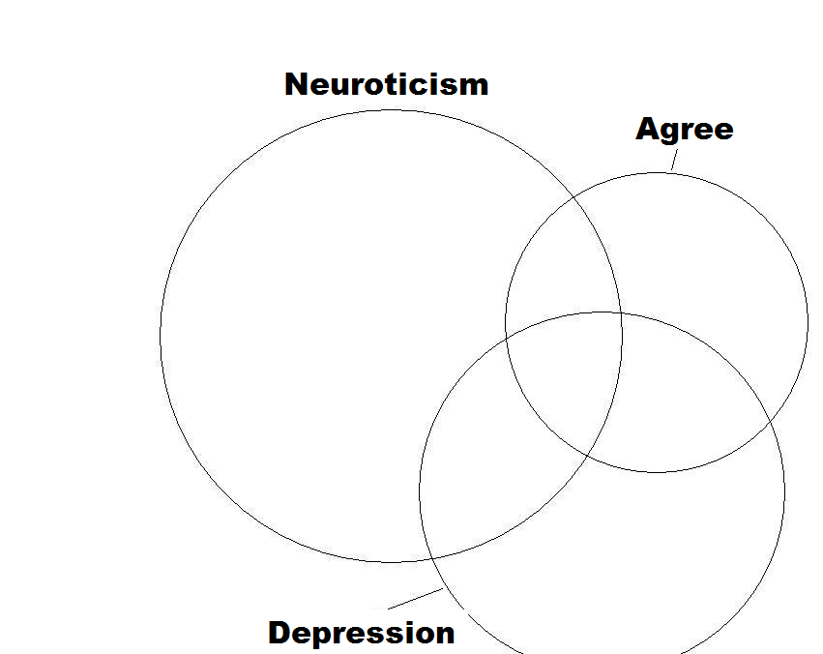
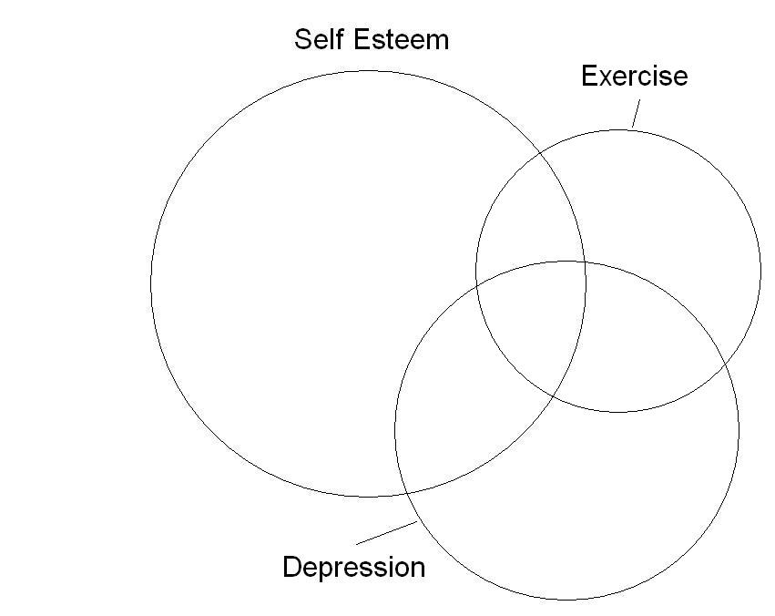
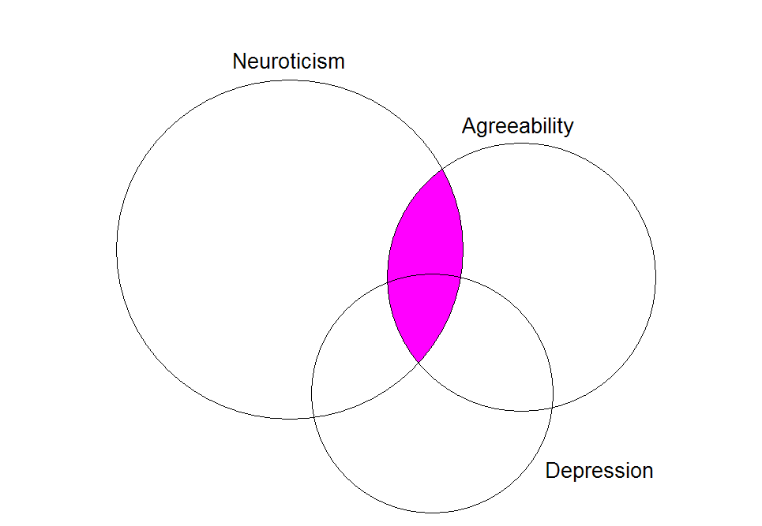

Slide 10
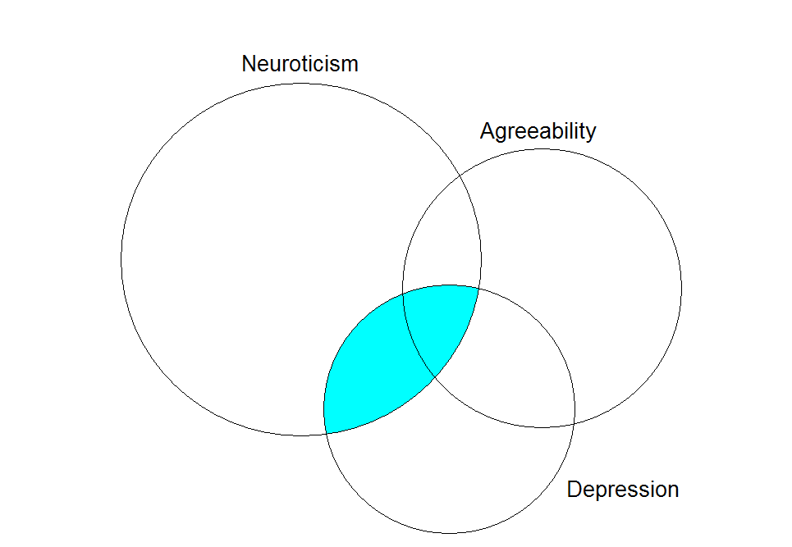

Slide 11
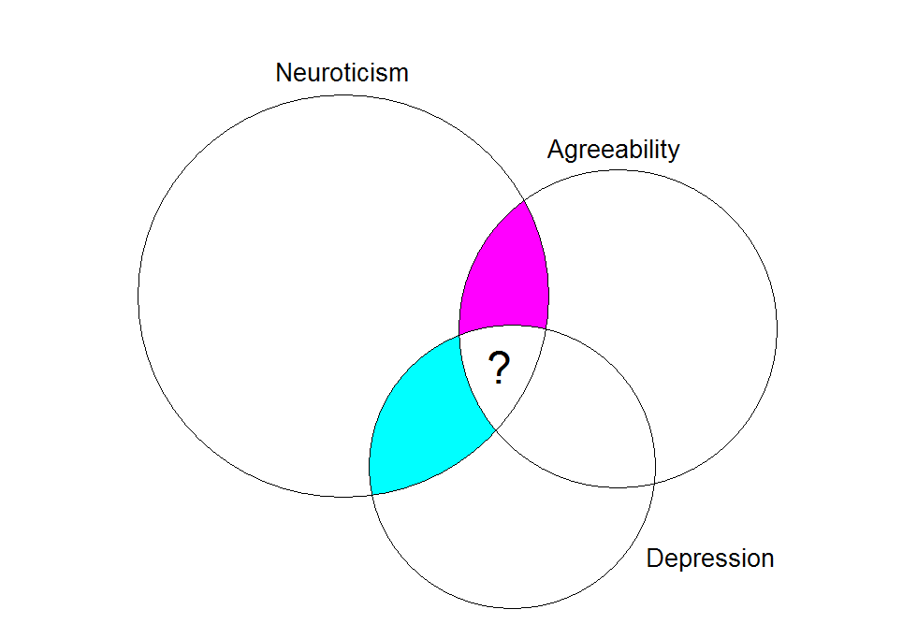

Slide 12
Added variable plots
In order to find what is unique about the relationship between a particular predictor (X₁) and Y
  Isolate the part of Y that cannot be described by other predictors
  Isolate the part of X₁ that cannot be described by other predictors
  Examine the relationship

Slide 13
Added variable plots (cont.)
What part of Neuroticism cannot be predicted by Depression?
The residuals from the regression of Neuroticism on Depression.
What part of Agreeability cannot be predicted by Depression?
The residuals from the regression of Agreeability on Depression.

Slide 14
Added variable plots (cont.)
The added variable plot looks at the relationship between those two sets of residuals.
So does multiple regression.
Doing AV plots in R

Slide 15
Interpretation of multiple regression
Multiple regression, just like simple regression, is a model for the conditional mean.
A slope in multiple regression represents change in conditional mean associated with a one-unit change in the predictor…
…while holding constant the other predictors.

Slide 16
Interpretation of multiple regression
The added variable plot gives us a way of understanding what it means to “hold constant” some variables.
In multiple regression, we look at the predictive ability of each independent variable…
…after quite literally removing the effects of the other variables.

Slide 17
Assumptions for inference in multiple regression
The relationships between predictors and the dependent variable must be linear.
The errors must be independent.
The errors must be homoscedastic.
The errors must be normally distributed.
In other words, the assumptions for multiple regression are essentially the same as for simple regression.

