Slide 1
Psychology 105
Advanced Research Methods
March 18, 2021

Slide 2
Meta-Analysis
Goal: Combine results across multiple studies
Effect sizes
  Standardized mean differences
  Transformed correlations
  Others (e.g., odds ratios, regression coefficients)
“Known” variances

Slide 3
Random-effects models
We know how variable effect sizes should be.
Most of the time they’re more variable than that.
Add a variance component, which recognizes that the model intercept is not the same for all studies.
Simplest case: two parameters to estimate, mean and vc.

Slide 4
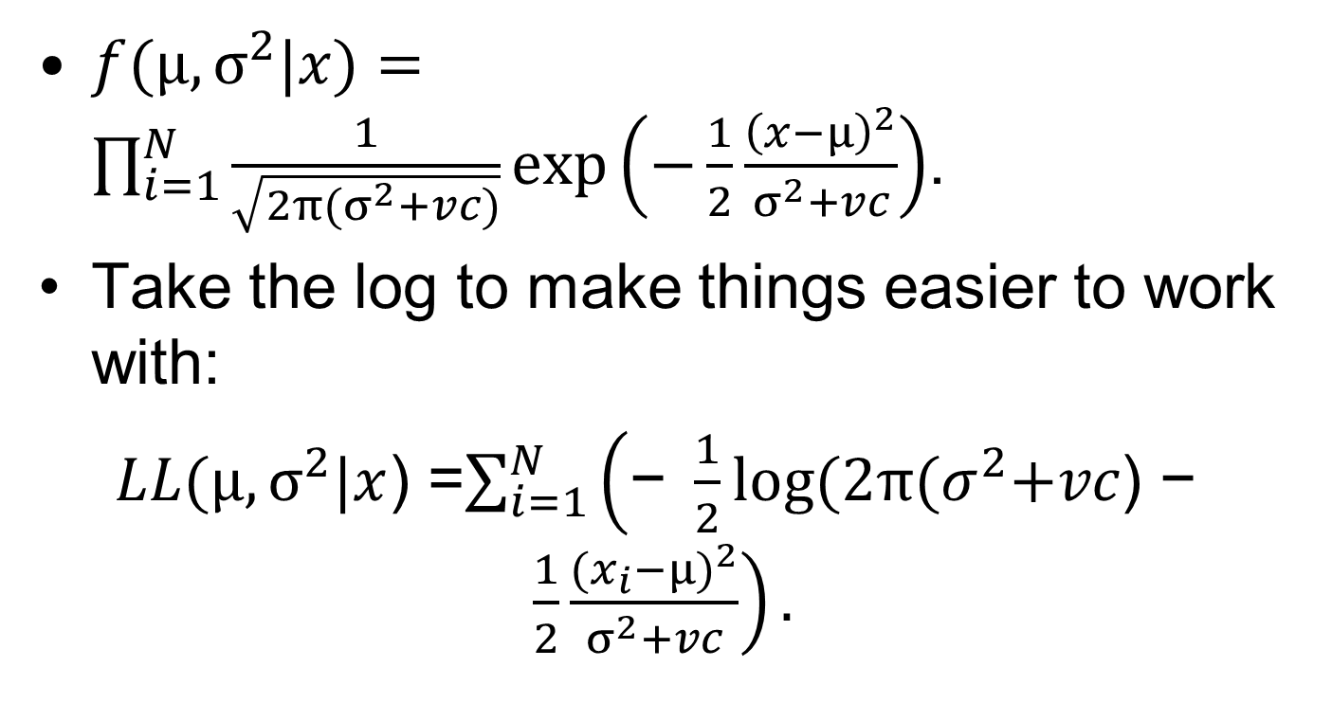
Likelihood
$f(μ,σ^{2}|x)=\prod_{i=1}^{N}{\frac{1}{\sqrt{2π{(σ}^{2}+vc)}}exp\left(−\frac{1}{2}\frac{{\left(x−μ\right)}^{2}}{σ^{2}+vc}\right)}$.
Take the log to make things easier to work with:
$LL(μ,σ^{2}|x$) =$\sum_{i=1}^{N}{\left(\text{− }\frac{1}{2}log⁡(2π{(σ}^{2}+vc\text{) − }\frac{1}{2}\frac{{(x_{i}−μ)}^{2}}{σ^{2}+vc}\right)}.$

Slide 5
Maximum Likelihood Estimation
Choose values of parameters that maximize the log likelihood.
Problem: mean and vc are not independent; the value of one depends upon the value of the other.
Iterative solutions to maximum likelihood estimation

Slide 6
Meta-analysis example
755 correlation coefficients comparing General Aptitude Test Battery general score to various job-performance outcomes.
Why random effects?
Fisher’s Z transformation gives known variance: 1/(N-3).

Slide 7
Iterative solutions in R
Demonstration of estimating mean, then vc, then mean, then vc…
Optimizers in R

Slide 8
Have a great spring break…
…but be careful!

