Slide 1
Psychology 105
Advanced Research Methods
March 16, 2021

Slide 2

Normal Density
$f\left(x | μ,σ^{2}\right)=\frac{1}{\sqrt{2πσ^{2}}}exp\left(−\frac{1}{2}\frac{{\left(x−μ\right)}^{2}}{σ^{2}}\right)$.
In R, equivalent to 1/sd(x) * dnorm((x-mean(x))/sd(x))

Slide 3
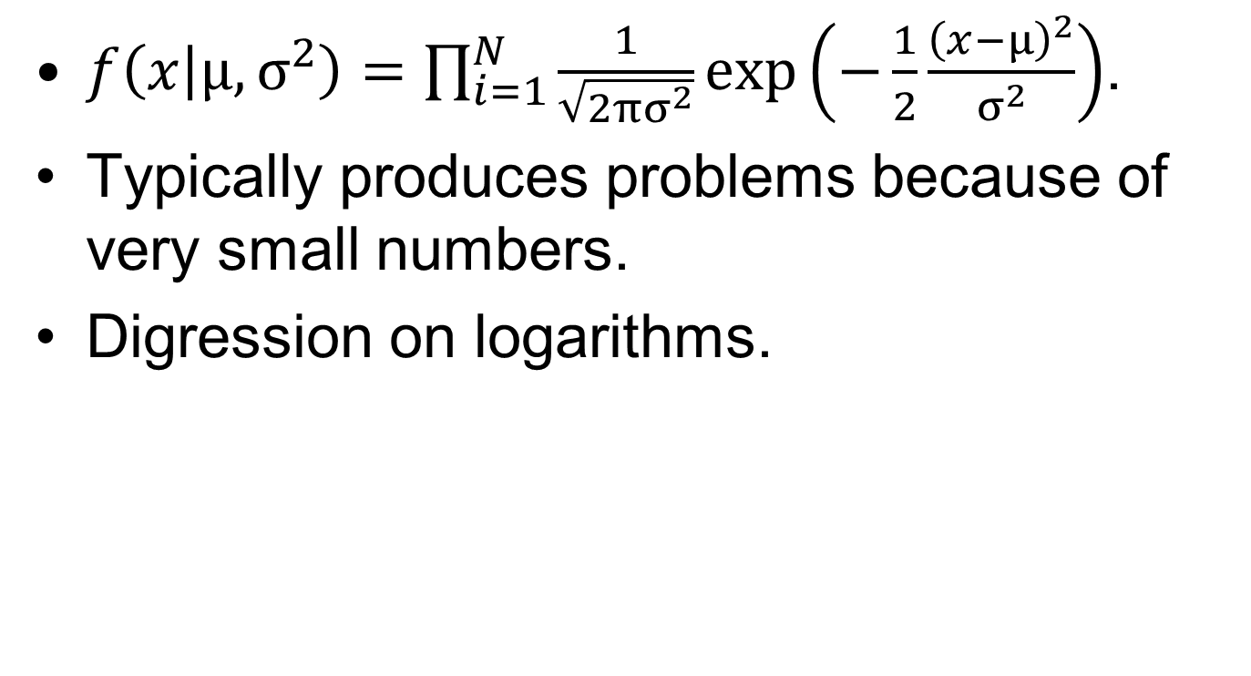
Normal Joint Density
$f\left(x | μ,σ^{2}\right)=\prod_{i=1}^{N}{\frac{1}{\sqrt{2πσ^{2}}}exp\left(−\frac{1}{2}\frac{{\left(x−μ\right)}^{2}}{σ^{2}}\right)}$.
Typically produces problems because of very small numbers.
Digression on logarithms.

Slide 4
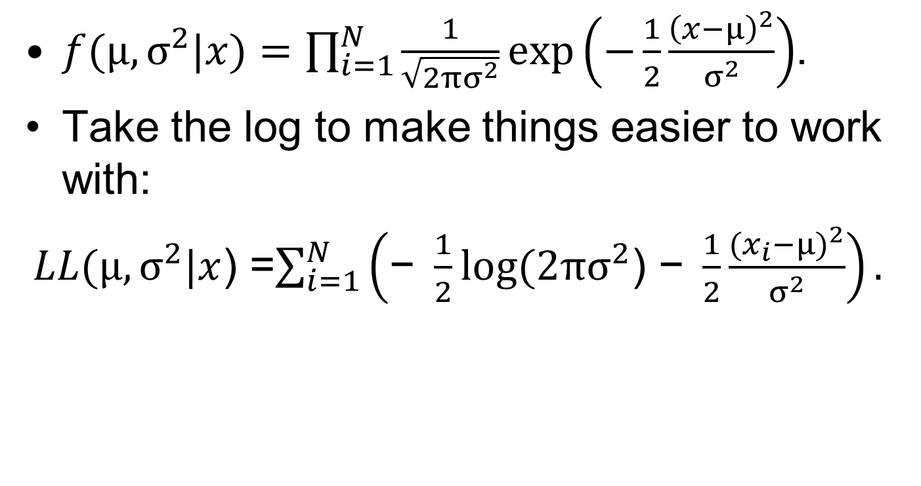
Likelihood
$f(μ,σ^{2}|x)=\prod_{i=1}^{N}{\frac{1}{\sqrt{2πσ^{2}}}exp\left(−\frac{1}{2}\frac{{\left(x−μ\right)}^{2}}{σ^{2}}\right)}$.
Take the log to make things easier to work with:
$LL(μ,σ^{2}|x$) =$\sum_{i=1}^{N}{\left(\text{− }\frac{1}{2}log⁡(2πσ^{2}\text{) − }\frac{1}{2}\frac{{(x_{i}−μ)}^{2}}{σ^{2}}\right)}.$

Slide 5
Maximum Likelihood Estimation
Choose values of parameters that maximize the log likelihood.

Slide 6
Properties of maximum likelihood estimates
Minimum variance estimators
  No other estimator has a less variable sampling distribution
Normal sampling distribution for large enough samples
Often biased
Bias is not necessarily bad

